Slide 1
Investment Planning And Analysis
Kerry Zhang
Tejesh Pattnaik
Prajwal Patnaik

Slide 2

Let’s talk about Money!

Slide 3
Overview
Objective: Develop a foundational algorithm for quantitative assessment of investment portfolios.
Quantitative Assessment: Create a robust algorithm to evaluate predefined investment portfolios, providing data-driven insights - Compare the five portfolios against the S&P 500 Index to gauge their performance and potential.
Monte Carlo Simulation: Employ Monte Carlo simulation to project expected returns for portfolios, establishing confidence intervals for an initial investment of $20,000.
Data Source and Analysis: Utilize stock data extracted from Yahoo Financials, focusing on a five-year timeframe from the current date. Note that simulation results may vary based on the chosen analysis timeframe.

Slide 4

Strategizing
Stage-1 - Portfolio Ideation: Portfolios comprise a diversity of assets, including small, medium, and large-cap indexes, low beta stocks, and traditional companies. S&P 500 is the benchmark.
Stage-2 – Quantitative Analysis: Volatility, Returns, Risk, and Sharpe ratios.
Stage-3 - Monte Carlo Simulation: Back-testing to validate our return hypotheses.

Slide 5
Defining Portfolios
Portfolio Construction
Source Diversity: Meticulously ideated and selected shares from S&P 500, NASDAQ, DOW JONES, and reliable online sources.
Correlation Minimization: Ensured no overlap with existing portfolios to minimize correlation.
Rationale
Low Beta (Low-Risk): Selected lowest Beta stocks with the highest market cap from MarketBeat.
Moderate-Risk: Included 5 stocks each from S&P Mid Cap Index and Vanguard Mid Cap Index.
Traditional Companies: Comprised the largest 10 stocks from Dow Jones Industrial Average.
High-Risk: Included 5 stocks each from S&P Small Cap Index and Vanguard Small Cap Index.
Growth: Included the largest 5 stocks from S&P 500 and NASDAQ.

Slide 6
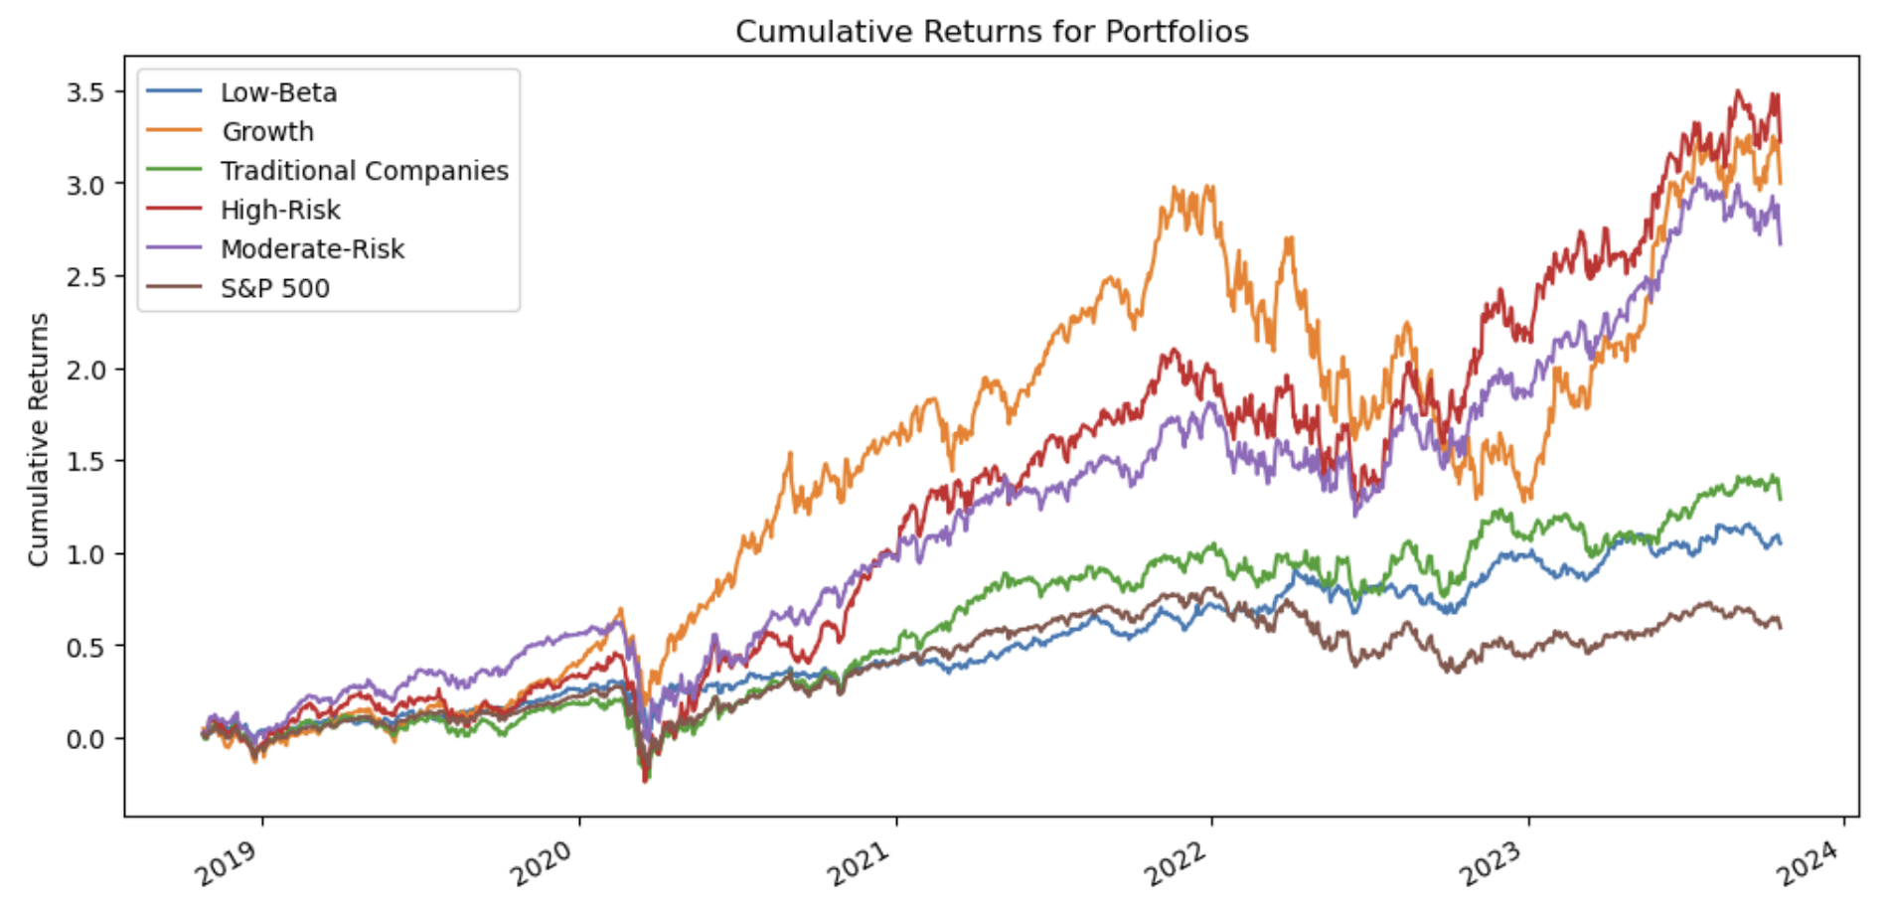
Returns
The High-Risk portfolio has the highest cumulative returns followed by Growth and Moderate-Risk portfolios.
Low-Risk and Traditional companies’ portfolio has the least alpha compared to the rest as expected.
Surprisingly, all our portfolios outperform the S&P 500.

Slide 7
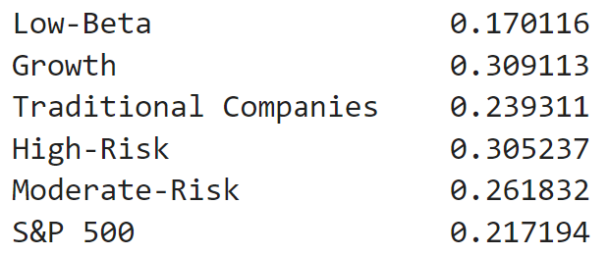
Volatility
Gauged using annualized standard deviation (252 trading days).
Low-Beta portfolio displays the lowest volatility – yet outperforms S&P 500.
The Growth and High-Risk portfolio have similar volatility, but the Growth portfolio slightly outranks the High-Risk portfolio.
Note: In the previous section, it was displayed that the high-risk portfolio had the highest cumulative returns followed by growth and they interchange when looking into volatility thus implying that these analyses can offer a rough guideline.

Slide 8
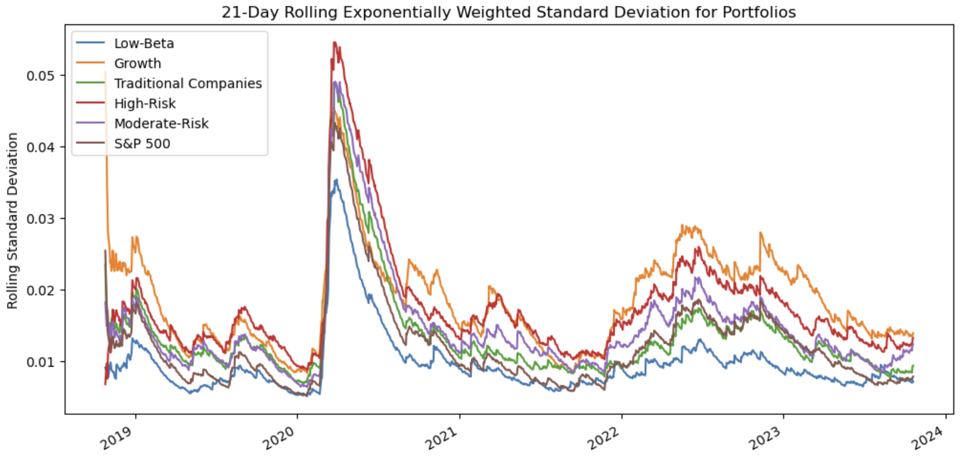
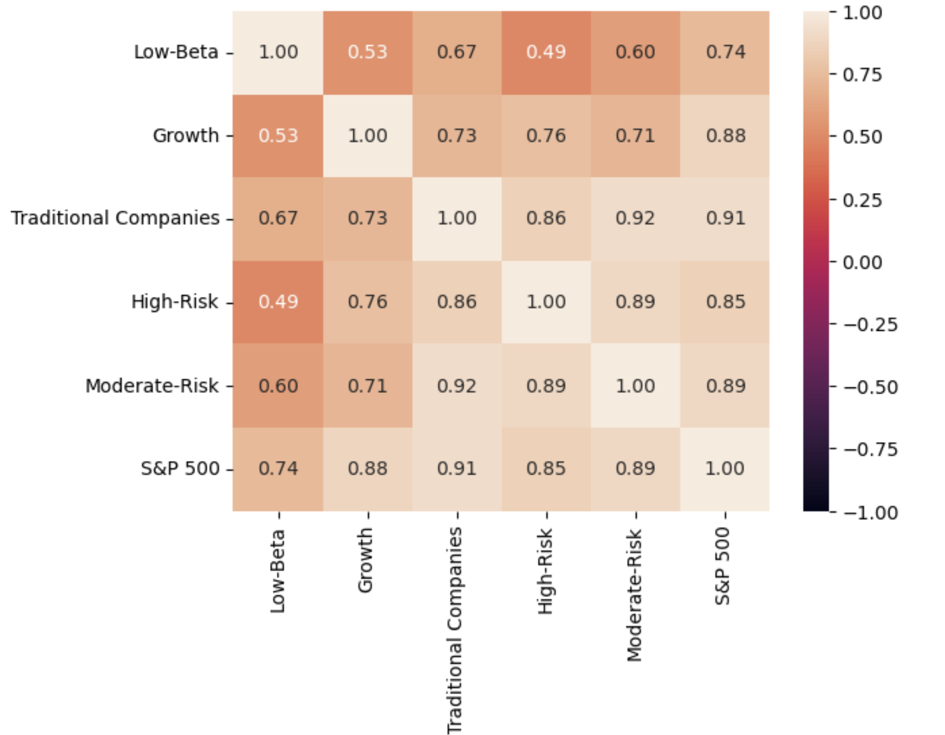
Risks
Exponentially weighted rolling statistics (EMAs) are more sensitive to recent data and are useful for capturing short-term trends and reacting quickly to changes in the time series.
The correlation plot reveals that the S&P 500 is closely correlated with our portfolios due to the data source. However, our portfolios show lower correlations with each other.

Slide 9
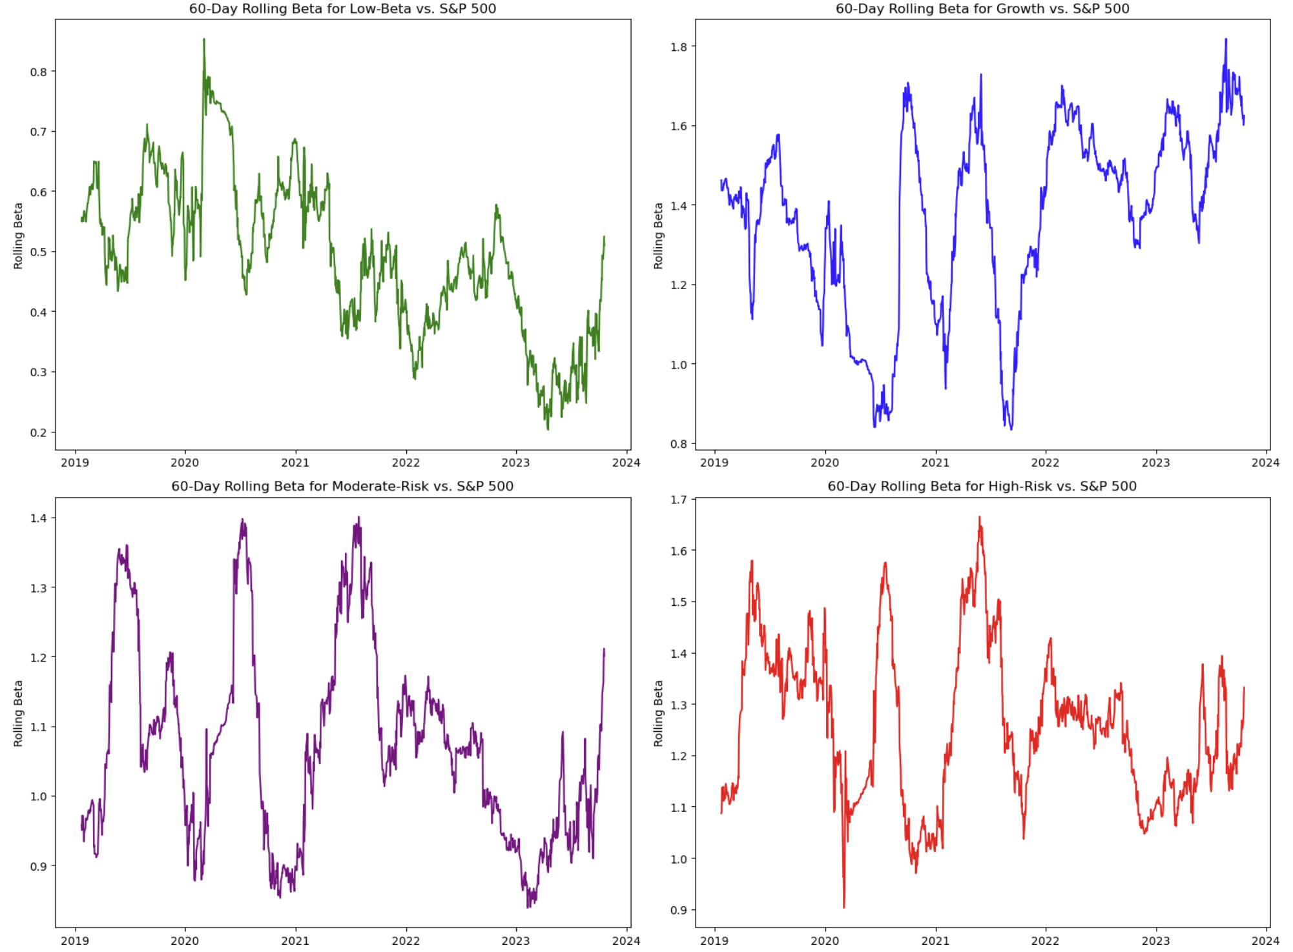
Risks
Benchmarked against S&P 500
Low-Risk: 0.5
High-Risk: 1.3
Growth: 1.6
Moderate-Risk: 1.2

Slide 10
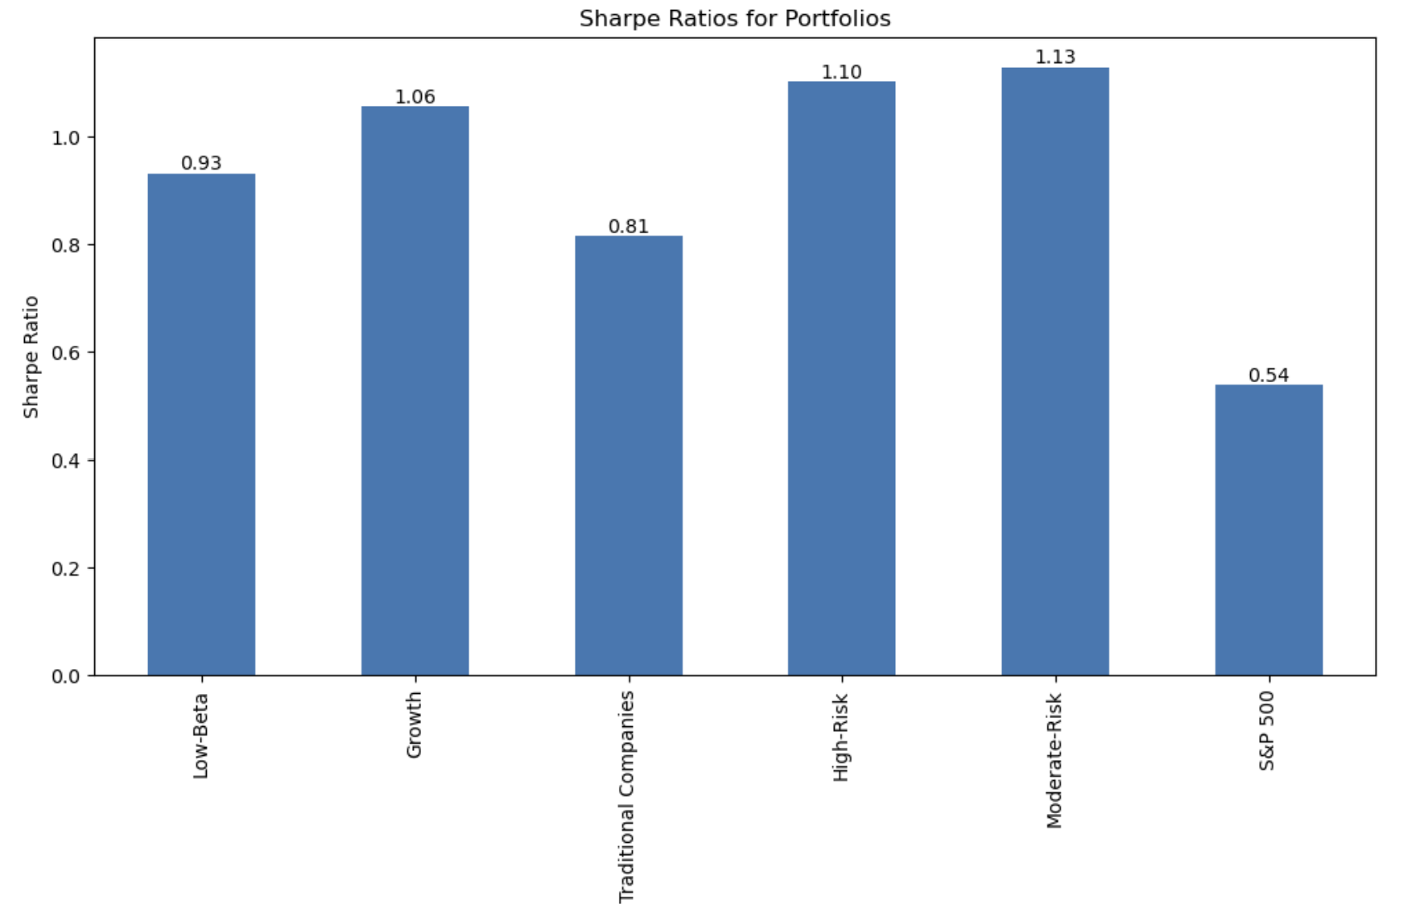
Risk to Return
While returns alone can provide a good understanding of where to invest, a return-to-risk analysis can help determine which portfolio to invest in when they offer almost identical returns but lower risk.
The Moderate-Risk portfolio stands out as it offers better returns with lower risk compared to the rest.
The High-Risk and Growth portfolios closely follow.

Slide 11
Monte Carlo
$20,000 initial investment over 5 years (1260 trading days) over 10,000 simulations
Portfolio | 95% Confidence Interval - Lower | 95% Confidence Interval - Upper
S&P 500 | $12,381.59 | $81,655.76
Low-Beta | $32,584.44 | $87,695.01
Moderate-Risk | $50,260.76 | $267,874.6
Traditional Companies | $31,024.06 | $97,972.13
Growth | $51,547.33 | $524,025.9
High-Risk | $52,601.12 | $239,269.63
Combination of 5 (equally distributed) | $41,787.31 | $143,166.21

Slide 12
Conclusions
Moderate-Risk Portfolio stood out among the crowd with a good risk-to-return value.
All the defined portfolios outperform the S&P 500 index.
The Low-Risk portfolio although less volatile and riskier than the S&P 500 offers comparatively better returns.
Growth portfolio indicates a possible mammoth return over the five-year tenure.
Users can mix and match strategies to align with their risk and reward preferences.
Strategies exhibit low correlation, reducing overall risk.
Portfolios offer exposure to various industries.
Significantly outperforms the S&P 500 in risk-adjusted returns.
Benefits

Slide 13
Future Scope
Automation of portfolio construction to disable any user bias or errors.
Caution: Our portfolios carry inherent risks since they rely solely on long equity strategies. During equity drawdowns, our portfolios are susceptible to impact. To mitigate this bias, exploring the addition of short strategies is a potential avenue.
Issues Faced: Certain stocks had a limited data range of only 2-3 years, leading to unrealistic Monte Carlo results. Consequently, we substituted them with the next most suitable alternatives.

Slide 14

Now that you have seen the Strategy, Would you like to Invest?

